Slide 1

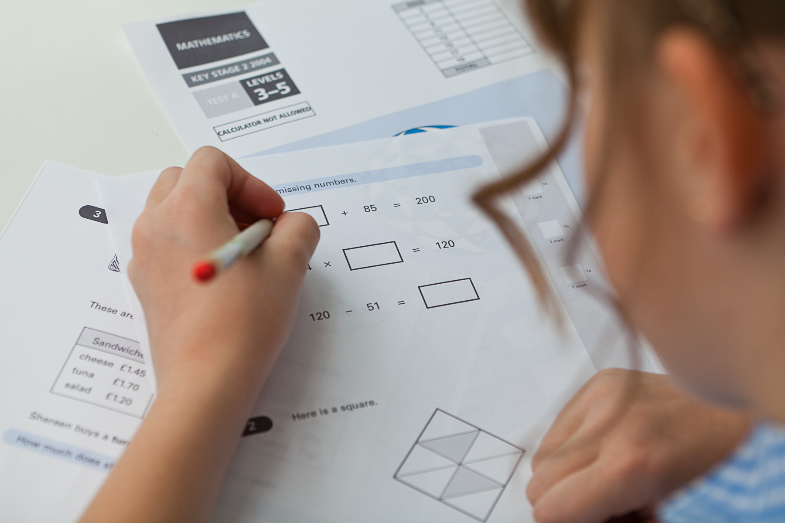




Y6 Parent meeting
SATs

Slide 2
What are the SATS?
KS2 assessments
12th – 15th May
Grammar, Punctuation and Spelling (Paper 1) Grammar, Punctuation and Spelling (Paper 2)
Reading
Maths Paper 1 (Arithmetic)
Maths Paper 2 (Reasoning)
Maths Paper 3 (Reasoning)
Writing – teacher assessment

Slide 3
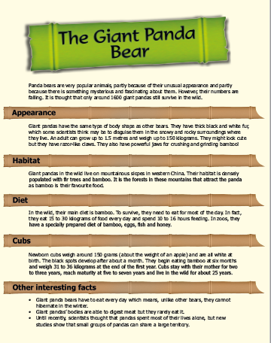
Reading

Slide 4
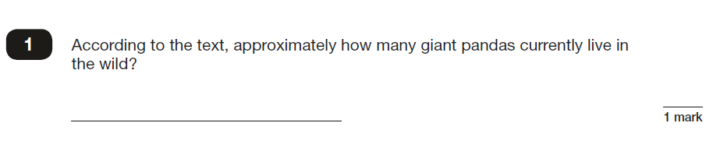
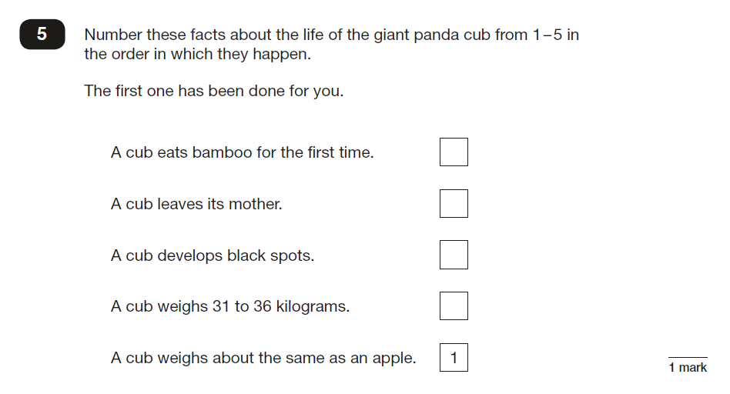
Reading

Slide 5
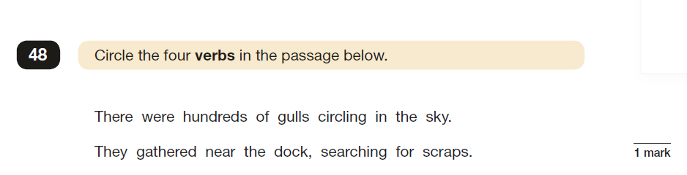
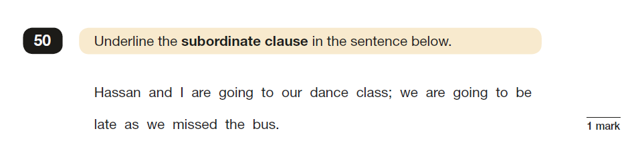
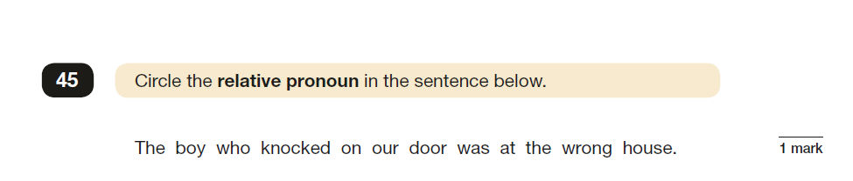
SPAG

Slide 6
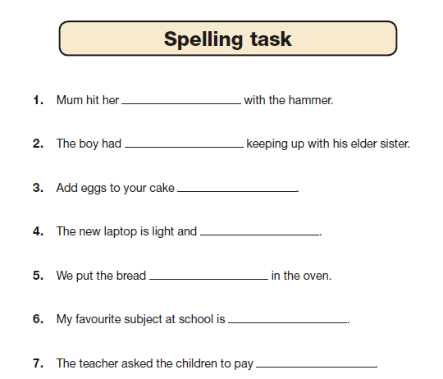
Spelling

Slide 7
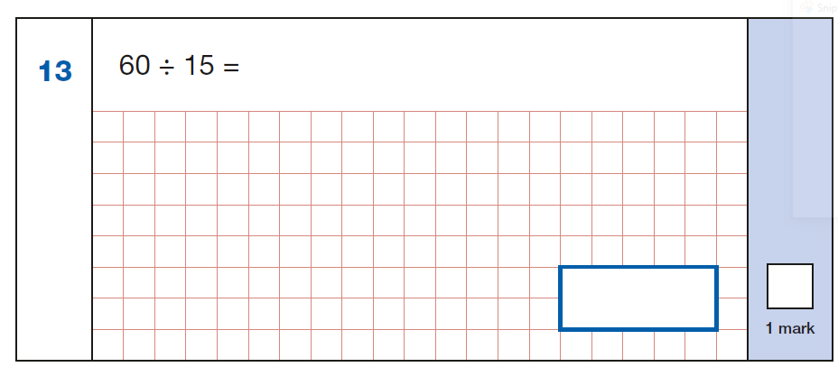
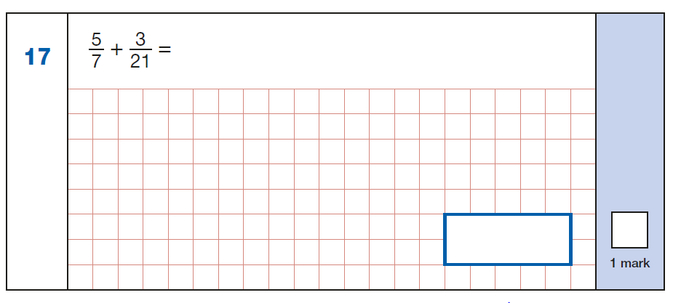
Arithmetic

Slide 8
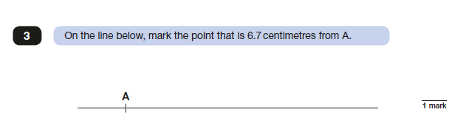
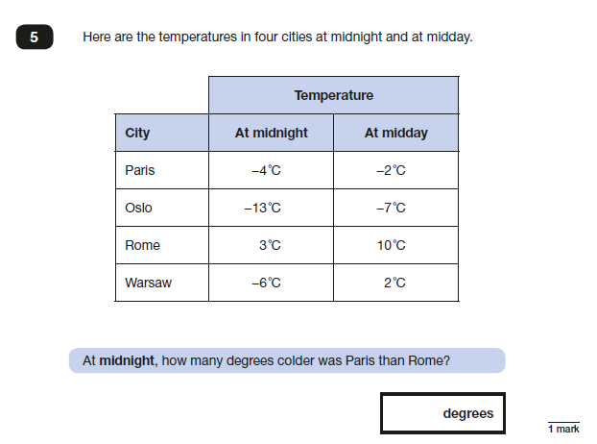
Reasoning

Slide 9
Specific arrangements for SATs:
Additional (extra) time;
Tests being opened early to be modified;
An adult to read for them;
An adult to scribe (write) for them;
Written or spoken translations of the mathematics reasoning papers;
The use of prompts or rest breaks;
Arrangements for children who are ill or injured at the time of the tests.

Slide 10
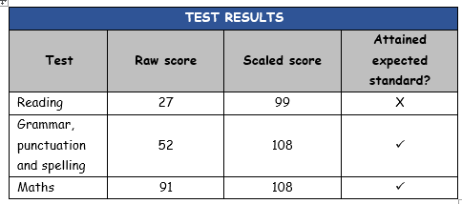
What sort of results are reported?
A raw score (the total number of marks achieved for each paper);
A scaled score
A judgement of whether the National Standard has been met.

Slide 12
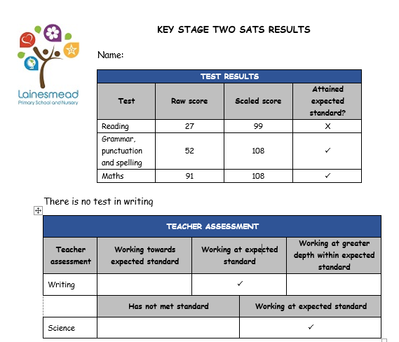
What will be reported to parents:

Slide 13
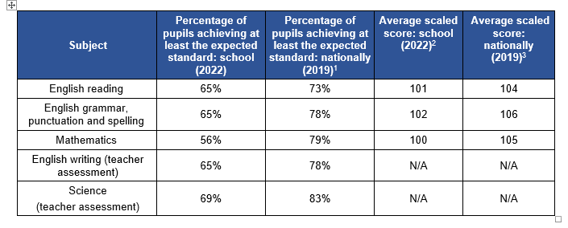

Slide 14
Assessing Writing

Slide 17
What we will do at Lainesmead:
Informal as possible
Support them in doing their best
Additional support – interventions
Practise
Breakfast

Slide 18
What you can do to help:
Questions to the teacher
Get them outside
Quiet corner
Talk to them
Fun weekends
Diet and sleep

Slide 19


Revision guides:

Slide 20
Remember:
SATs only focuses on Reading and Maths!
SATs results don’t tell the whole story
They only last for 1 week

Slide 21


